Slide 1


Gold Prices Prediction Using Machine Learning
American International University-Bangladesh

Slide 2
Group Members
Name | ID | Department
JOTHIRMOY SARKER SHUVO | 22-46473-1 | CSE
MD.MUJTAHID HASSAN | 22-47427-2 | CSE

Slide 3
Introduction
The Importance of Gold
Cultural Value
Financial Stability
Industrial Applications
Importance of Gold Price Prediction
Investors
Economists:
Businesses
Central Banks
Role of Machine Leaning in Gold Price Prediction
Data Processing
Pattern Recognition
Real-Time Forecasting
Improved Accuracy

Slide 4
Problem Statement
Volatility in Gold Prices
Gold prices fluctuate due to multiple factors like inflation, exchange rates, and geopolitical events.
Challenges with Traditional Methods
Conventional prediction methods lack accuracy and struggle with complex data.
Need for Accurate Forecasting
Investors, businesses, and policymakers require precise predictions to make informed decisions.
Solution with Machine Learning
Use machine learning to analyze historical trends and influencing factors for better gold price predictions.

Slide 5
Objectives
Accurate Prediction:
Develop a machine learning model to predict gold prices with high accuracy.
Data Analysis:
Analyze Limited quantity of data set to predict gold prices.
Risk Management:
Help investors and stakeholders minimize risks and make informed financial decisions.
Decision Support:
Provide actionable insights for policymakers, businesses, and traders to optimize strategies.
Scalability:
Build a flexible model that can adapt to changing market conditions and new data sources.

Slide 6
Dataset Overview
Dataset Used: Kaggle Diabetes Dataset
Key Features:
Date
price
Target Variable:
Predicted gold price (USD per ounce).
Dataset Size:
Columns: 2
Rows: 886

Slide 7
Methodology
Data Collection:
Collect historical gold price data (1950–2020) from reliable sources Kaggle.
Data Standardization:
Standardize features to ensure consistent scales for machine learning algorithms
Feature Analysis:
Generate boxplot and graph to identify relationships between features.
Algorithm Selection:
Logistic Regression.
Time Series.
Decision Tree.
Long Short-Term Memory (LSTM).
K-Nearest Neighbors (KNN).

Slide 8
Results
Classifier | MAPE | Accuracy
Logistic Regression | 29.75% | 70.25%
Decision Tree | 41.49% | 58.51%
K-Nearest Neighbors | 48.05% | 51.95%
Time Series | 19.38% | 80.62%
Long Short-Term Memory | 13.56% | 86.44%

Slide 9
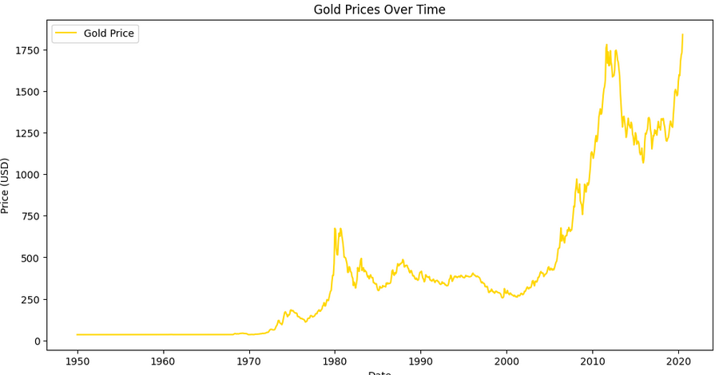
Results

Slide 10
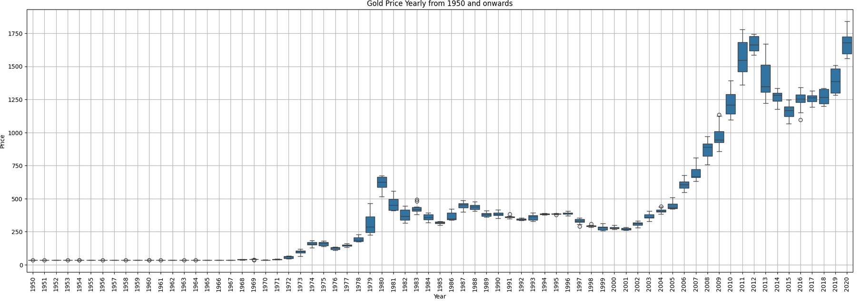
Results

Slide 11
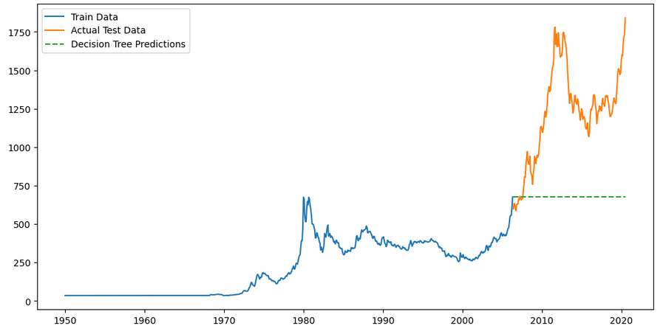
Results

Slide 12
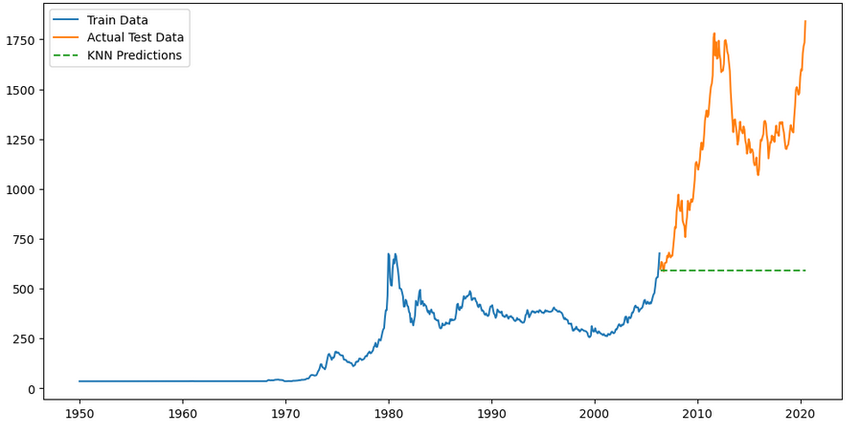
Results

Slide 13
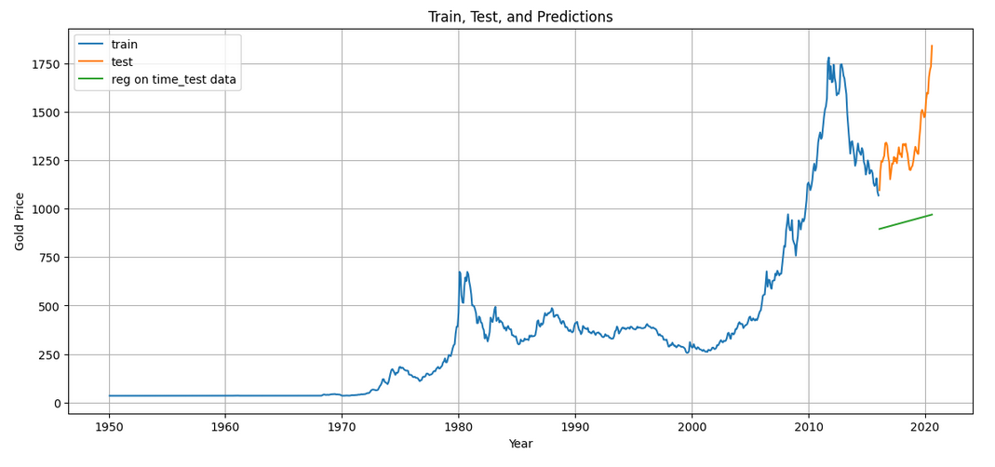
Results

Slide 14
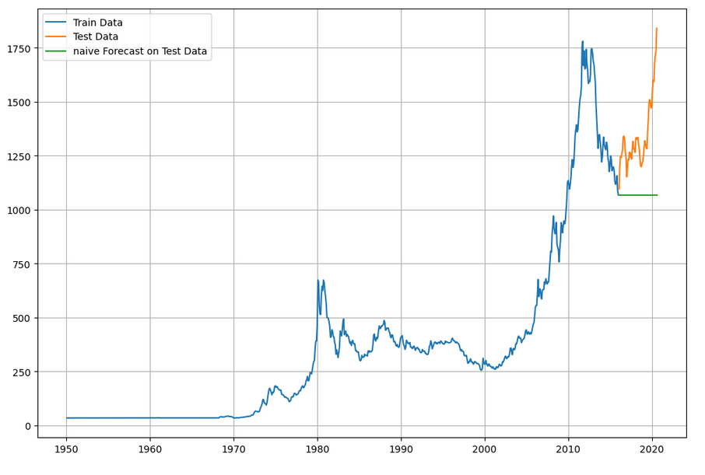
Results

Slide 15
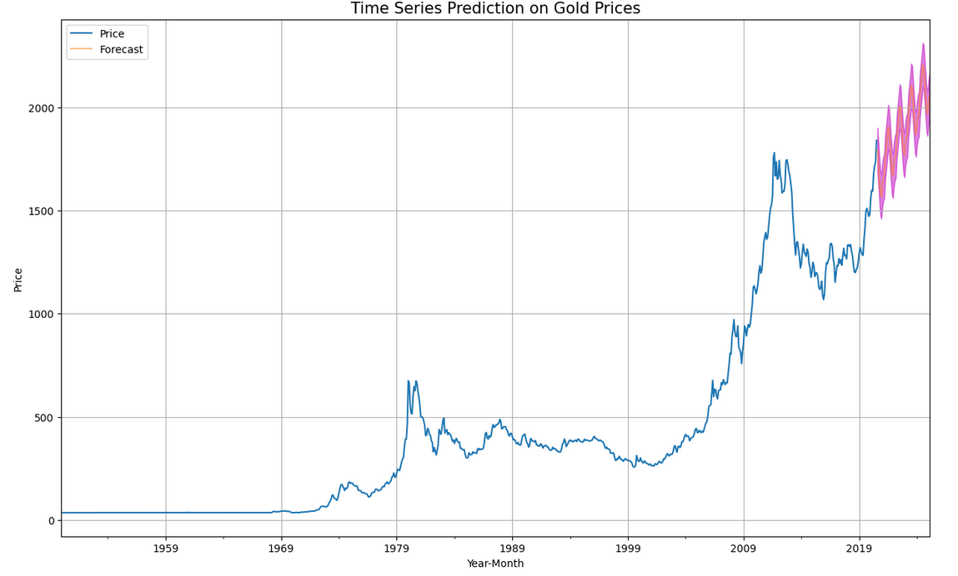
Results

Slide 16
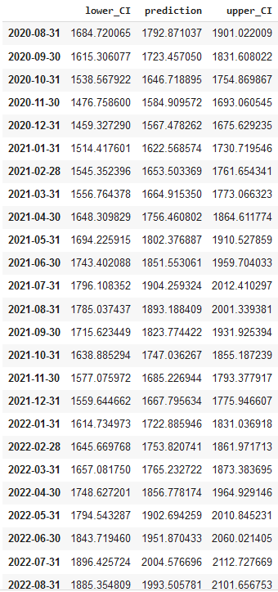
Results

Slide 17
Your best quote that reflects your approach… “It’s one small step for man, one giant leap for mankind.”
- Neil Armstrong

